Slide 1
Virtual Memory
Virtual memory, Translation lookaside buffer(tlb),demand paging, Thrashing, page replacement algorithm, working set model

Slide 2
Introduction to Virtual Memory
Definition: Virtual memory enables a system to use more memory than physically available by using disk space as an extension of RAM.
Benefits:
Supports multitasking and large applications.
Provides process isolation.
Simplifies programming by abstracting physical memory.
Concepts:
Address space separation: Virtual vs. Physical.
Enables efficient use of memory resources.

Slide 3
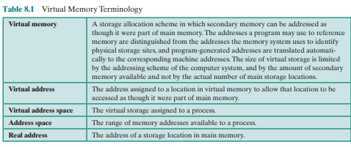
Virtual Memory

Slide 4
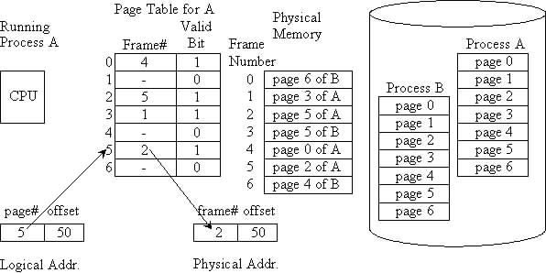
Virtual memory

Slide 5
Translation Lookaside Buffer (TLB):
Definition: A small, high-speed cache that stores recent translations of virtual memory addresses to physical addresses.
Functionality:
Reduces the time taken to access the page table for address translation.
Avoids repeated memory lookups for frequently accessed pages.
Structure:
Associative memory structure for quick matching.
Advantages:
Improves performance significantly in systems with frequent memory access.
Reduces latency associated with page table lookups.
Limitations:
Limited size: Can only store a small number of entries.
TLB misses require a fallback to the page table, incurring additional latency.

Slide 6
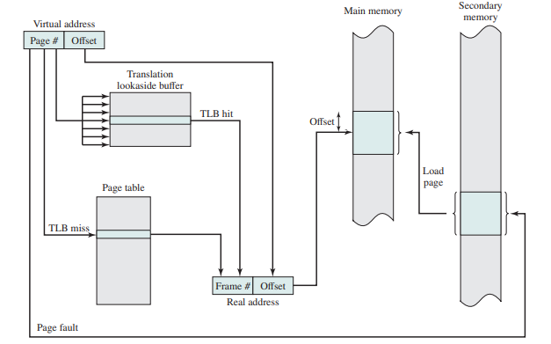
Translation Lookaside Buffer (TLB):

Slide 7
Demand Paging:
Definition: A technique where pages are loaded into memory only when they are needed, rather than preloading all pages of a process.
How It Works:
When a process accesses a page not currently in memory, a page fault occurs.
The operating system retrieves the page from disk and loads it into memory.
Advantages:
Saves memory by loading only necessary pages.
Reduces initial load time for processes.
Disadvantages:
Page faults can slow down execution.
Overhead from frequent disk access if too many page faults occur.
Example:
Process needs pages A, B, C, D.
Pages A and B are loaded initially.
When the process accesses C, a page fault occurs, and C is loaded from disk.

Slide 8
Thrashing:
Excessive paging activity causing performance degradation.
Mitigated by adjusting working sets.

Slide 9
The Working Set Model
Definition:
The working set of a process is the set of pages it has referenced within a recent time window (∆).
Key Concepts:
Window Size (∆): Determines the recent time period to track references.
Working Set Size (WSS): Number of pages in the working set.
Dynamic Behavior: Adjusts as processes access different pages.
Applications:
Prevents thrashing by ensuring processes have enough pages.
Helps OS allocate memory efficiently.
Example:
Process accesses pages: 1, 2, 3, 4, 1, 2, 5, 1, 2, 3, 4, 5.
With ∆ = 4, the working set changes dynamically:
After referencing page 5: {2, 3, 4, 5}.

Slide 10
Page Replacement Algorithms First-In-First-Out (FIFO):
Replaces the oldest page in memory that was loaded first.
Advantages:
Simple to implement.
Disadvantages:
May replace frequently used pages, leading to high page faults.
Example:
Reference string: 7, 0, 1, 2, 0, 3, 0, 4, 2, 3, 0, 3, 2
Frames: 3
Total Page Faults: 9

Slide 11
Least Recently Used (LRU):
Replaces the page that has not been used for the longest time.
Advantages:
Reduces page faults by considering usage patterns.
Disadvantages:
Overhead to track recent usage.
Example:
Reference string: 7, 0, 1, 2, 0, 3, 0, 4, 2, 3, 0, 3, 2
Frames: 3
Total Page Faults: 10

Slide 12
Optimal Page Replacement:
Replaces the page that will not be used for the longest time in the future.
Advantages:
Minimal page faults (theoretical best).
Disadvantages:
Requires future knowledge of reference string.
Example:
Reference string: 7, 0, 1, 2, 0, 3, 0, 4, 2, 3, 0, 3, 2
Frames: 3
Total Page Faults: 7

Slide 13
Most Recently Used (MRU):
Replaces the most recently used page.
Advantages:
Useful when recently used pages are less likely to be reused.
Disadvantages:
Poor performance in certain scenarios.
Example:
Reference string: 7, 0, 1, 2, 0, 3, 0, 4, 2, 3, 0, 3, 2
Frames: 3
Total Page Faults: 10

